Slide 1
Euler Method
by
Dr. Md. Rajibul Islam
CSE, UAP
*
‹#›

Slide 2
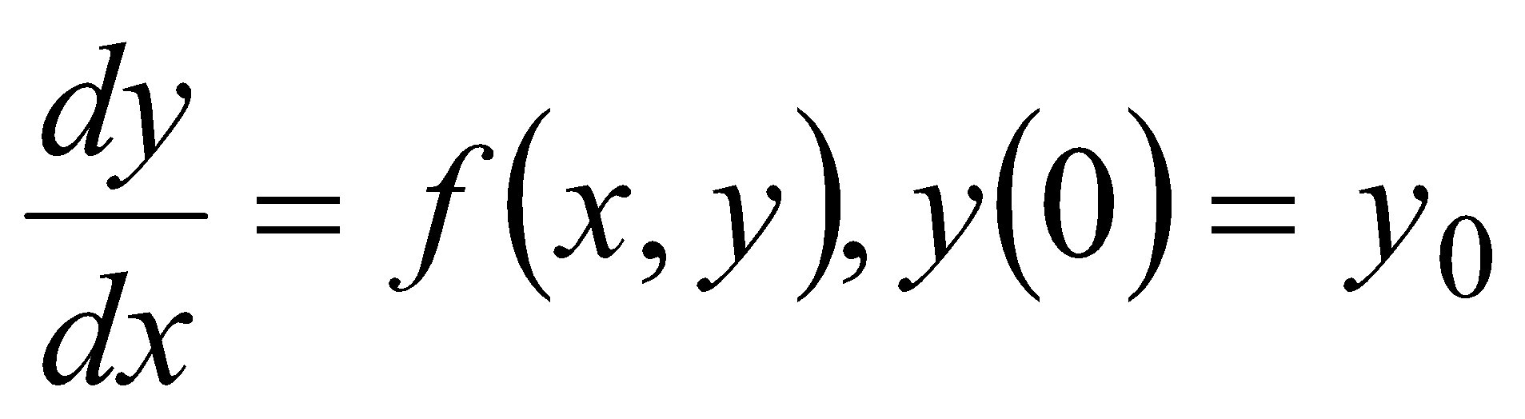
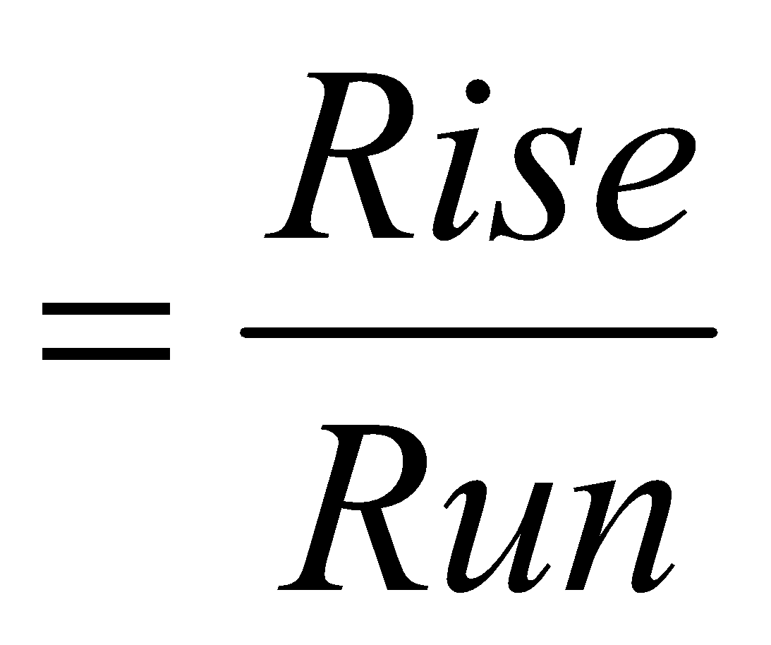
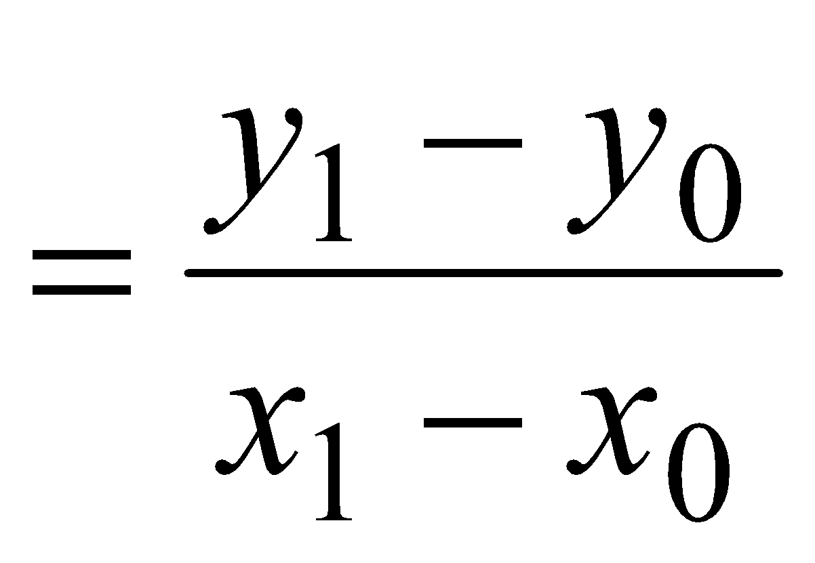
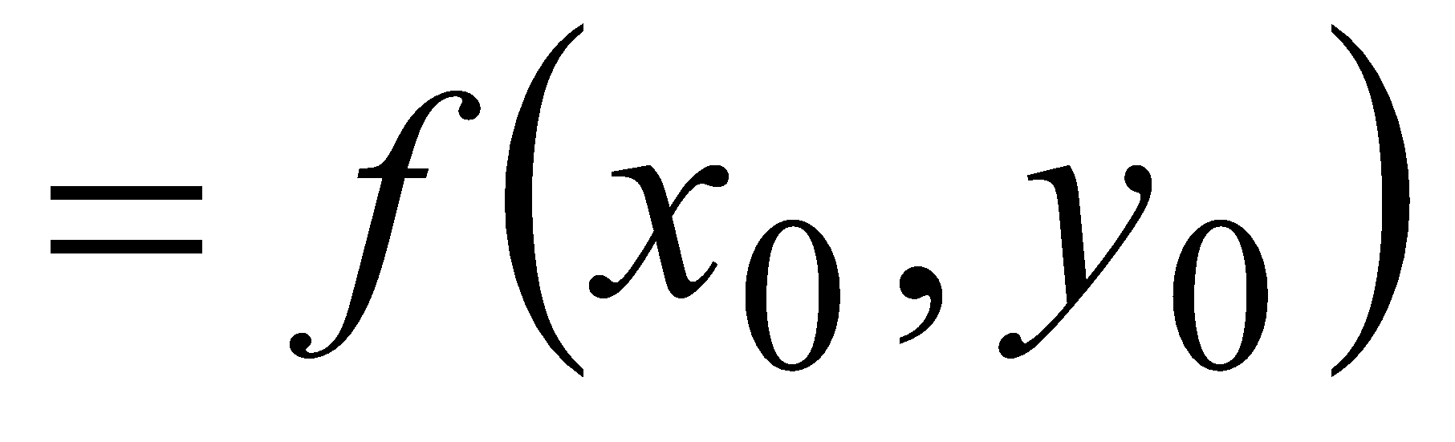
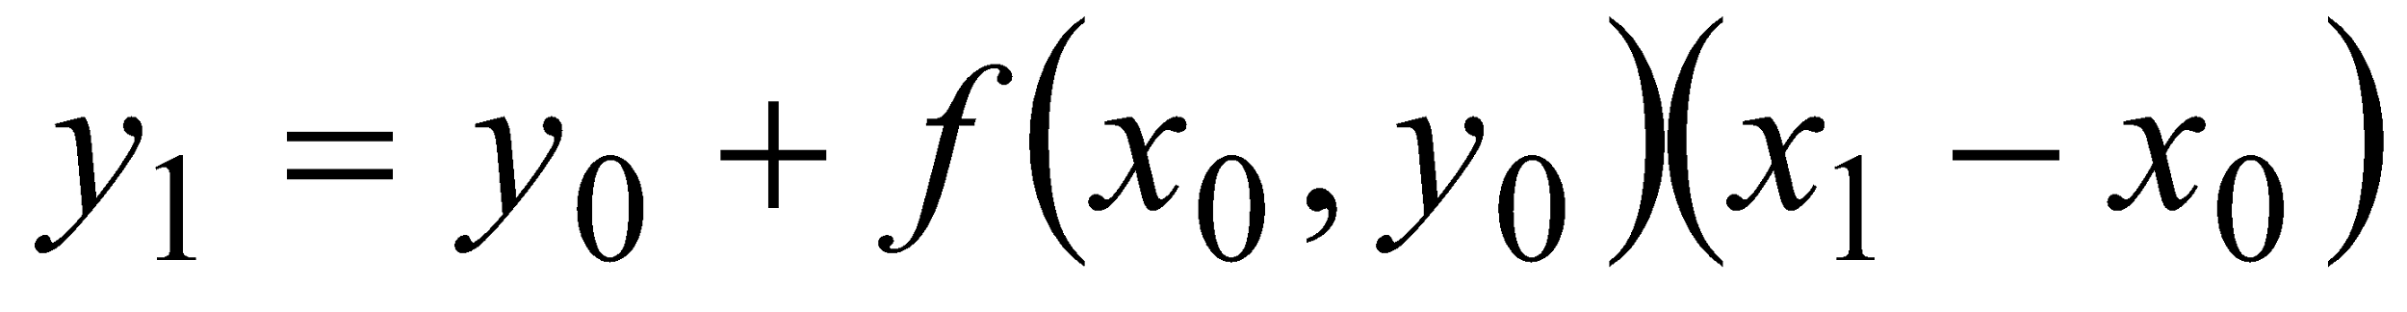
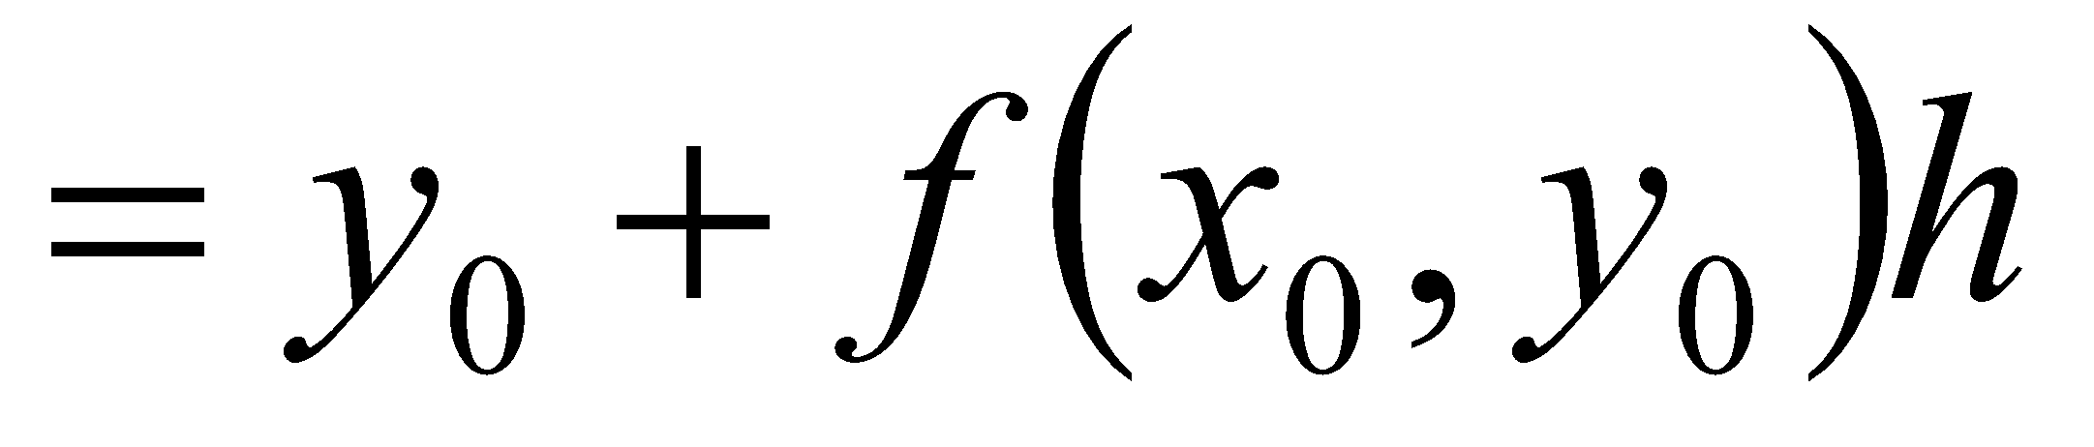
Euler’s Method
y
True value
y₁, Predicted
value
Slope
x₀,y₀
Φ
Step size, h
x₁
x
Figure 1 Graphical interpretation of the first step of Euler’s method
‹#›

Slide 3
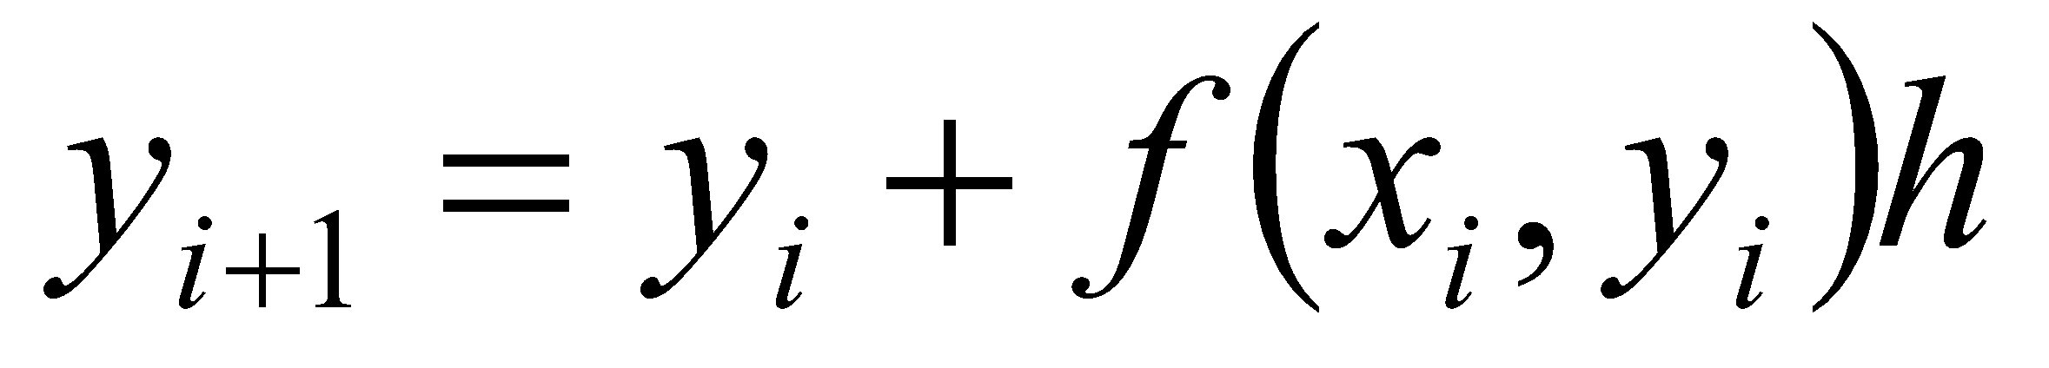
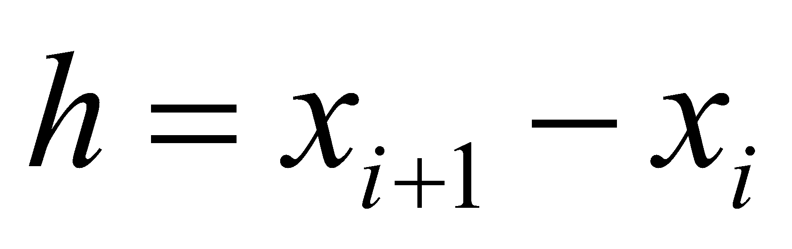
Euler’s Method
y
True Value
where
y_{i+1}, Predicted value
y_{i}
Φ
h
Step size
x
x_{i}
x_{i+1}
Figure 2. General graphical interpretation of Euler’s method
‹#›

Slide 4
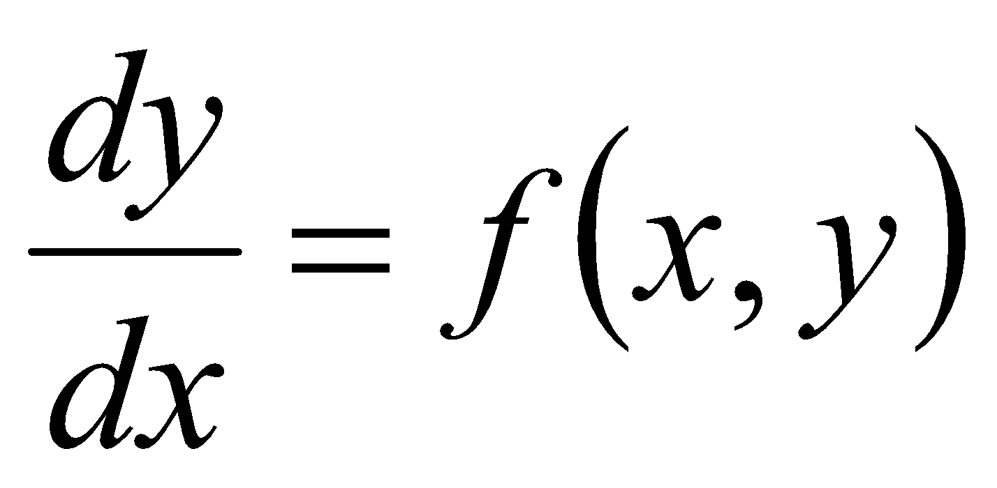
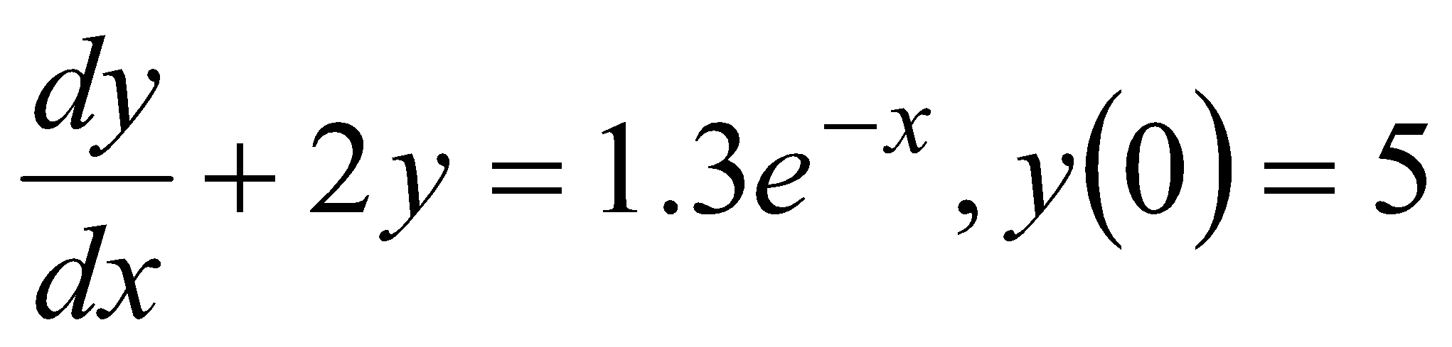
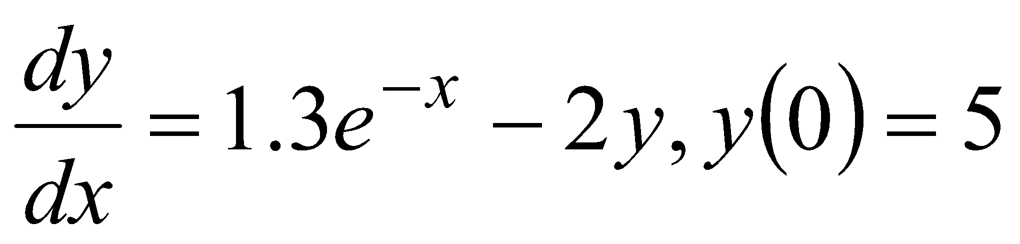
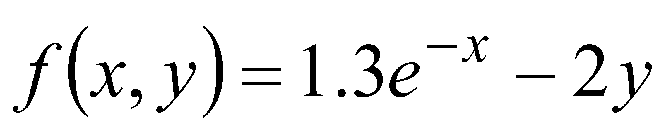
How to write Ordinary Differential Equation
How does one write a first order differential equation in the form of
Example
is rewritten as
In this case
‹#›

Slide 5
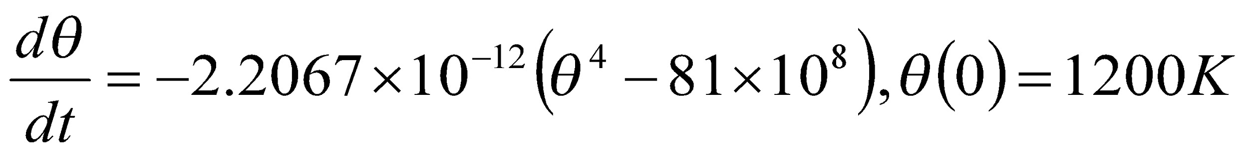
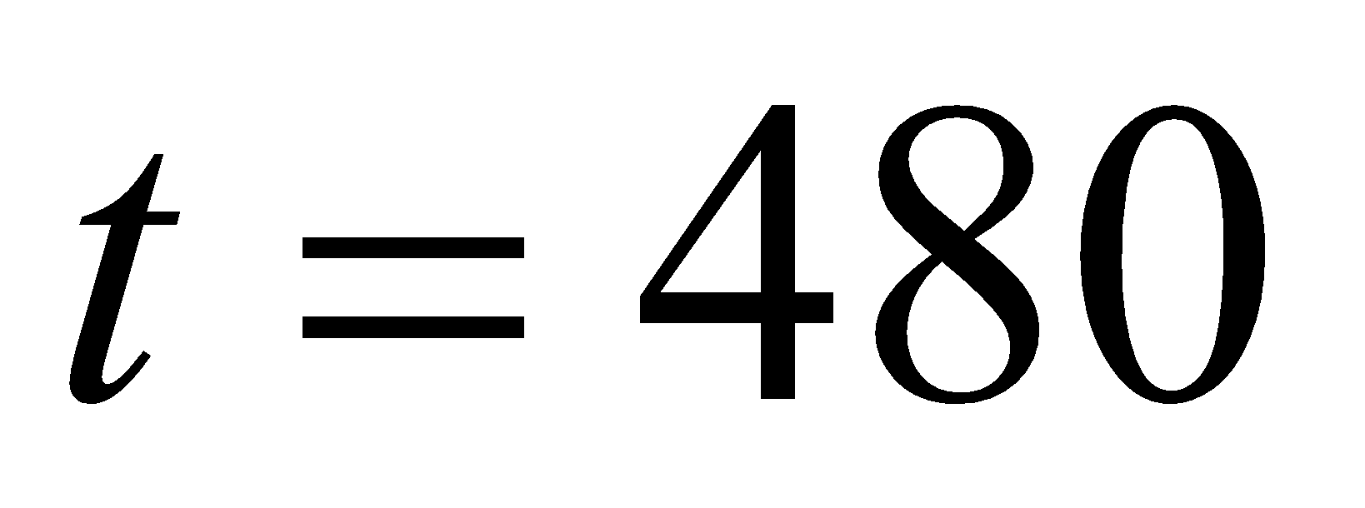
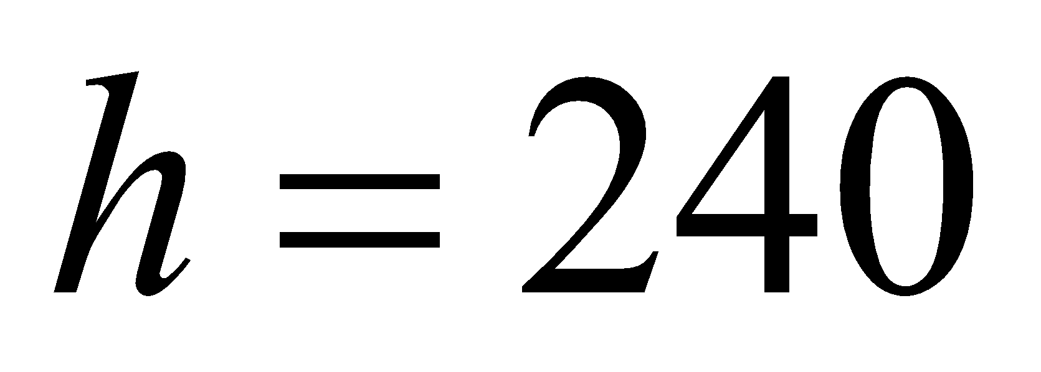
Example
A ball at 1200K is allowed to cool down in air at an ambient temperature of 300K. Assuming heat is lost only due to radiation, the differential equation for the temperature of the ball is given by
Find the temperature at
seconds using Euler’s method. Assume a step size of
seconds.
‹#›

Slide 6
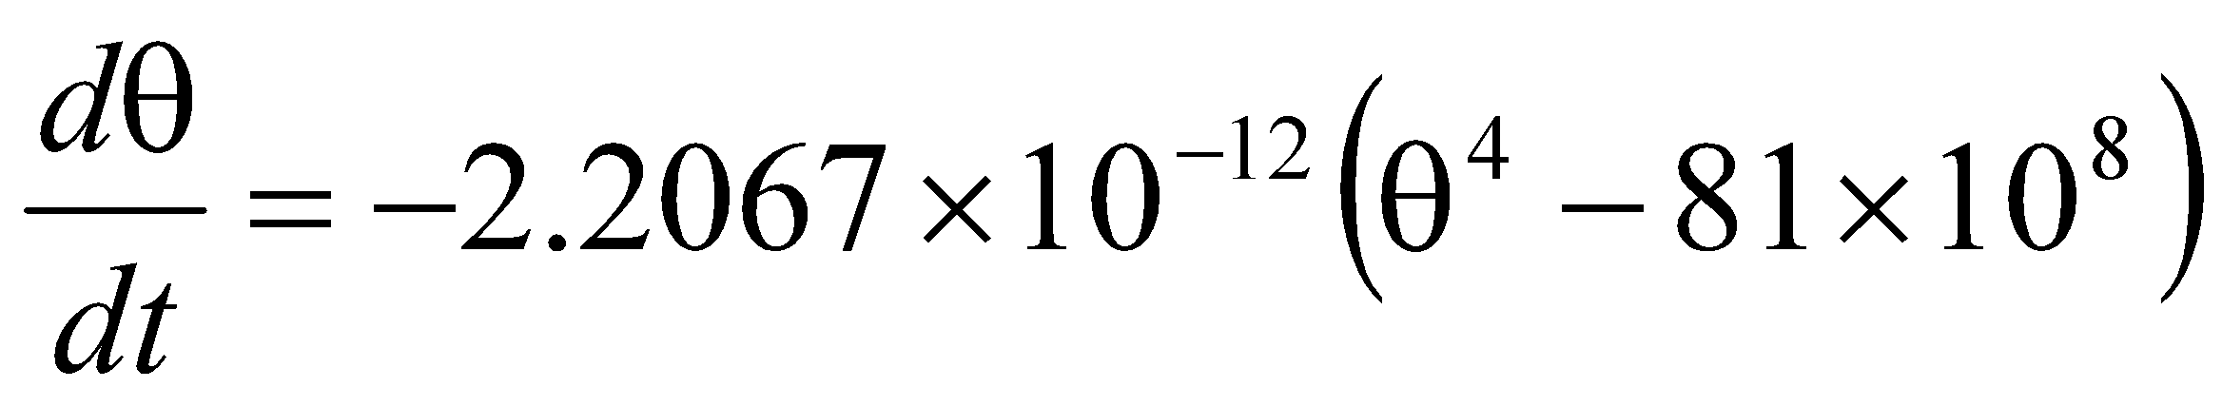
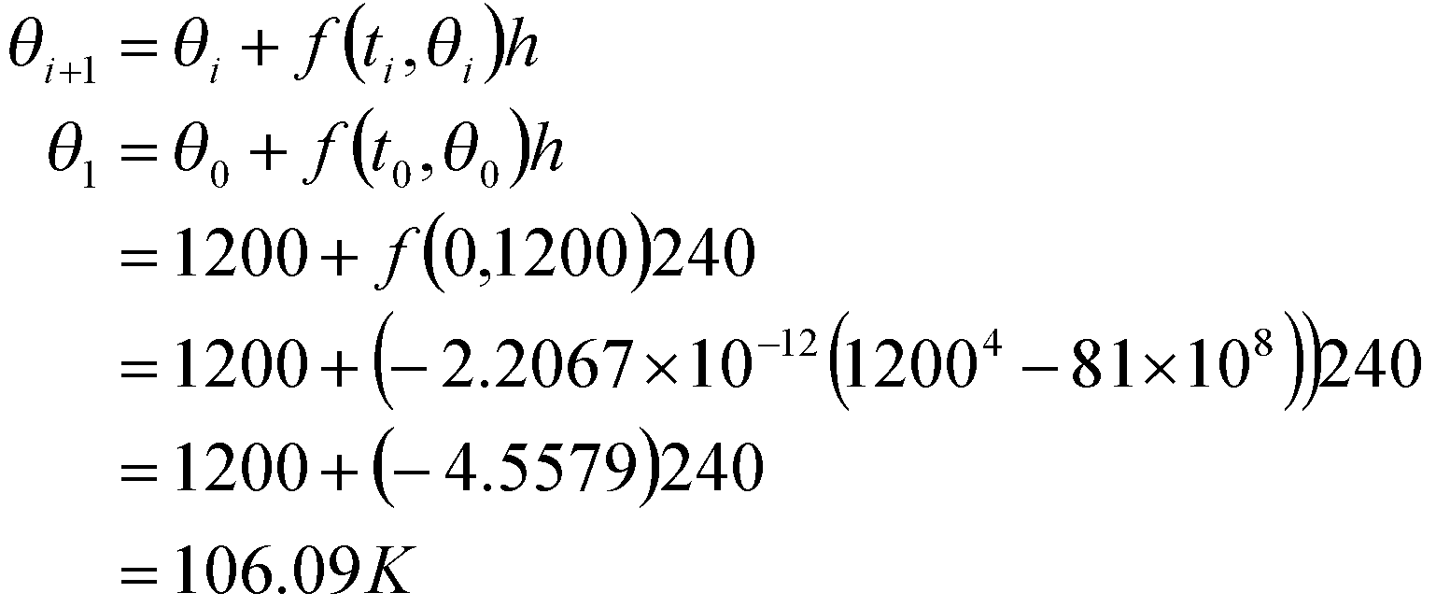
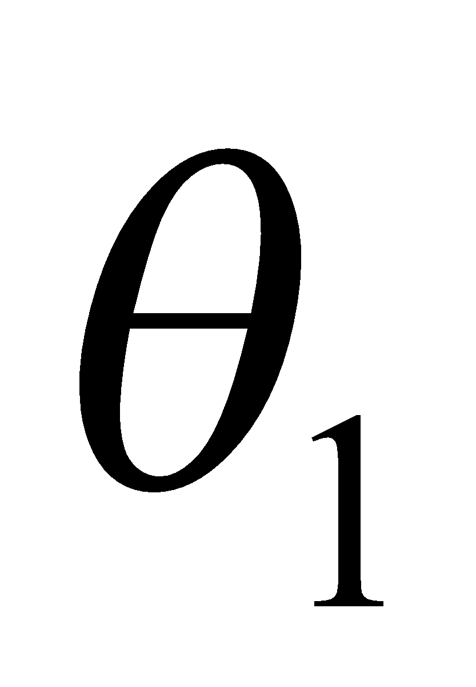
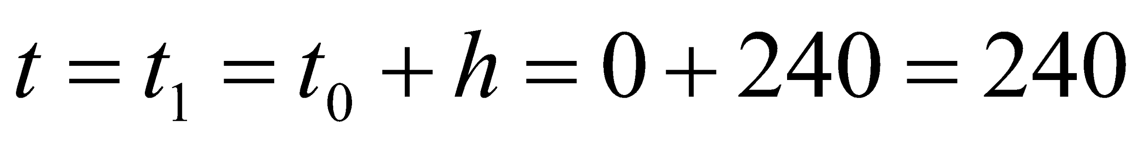
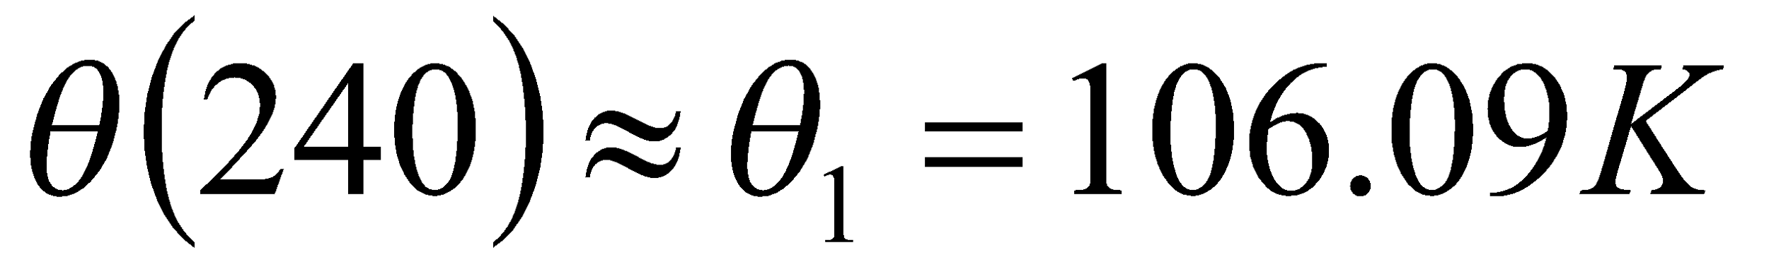
Solution
Step 1:
is the approximate temperature at
‹#›

Slide 7
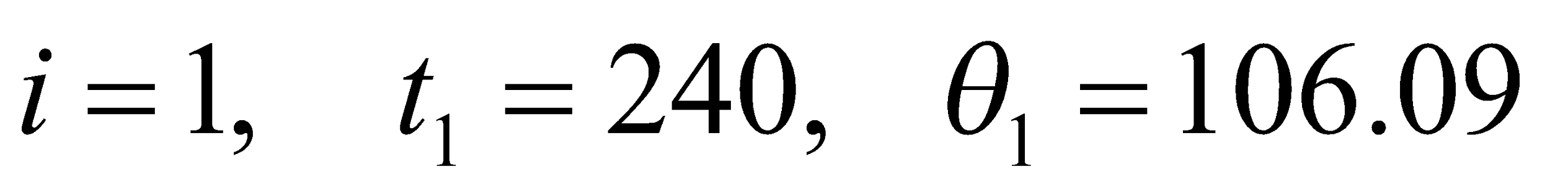
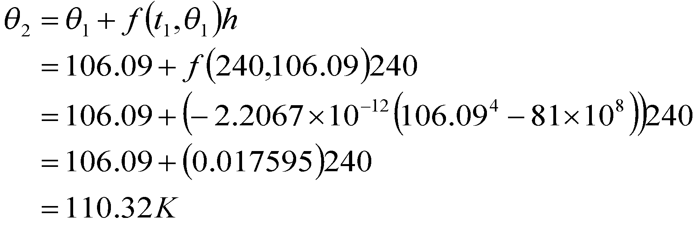
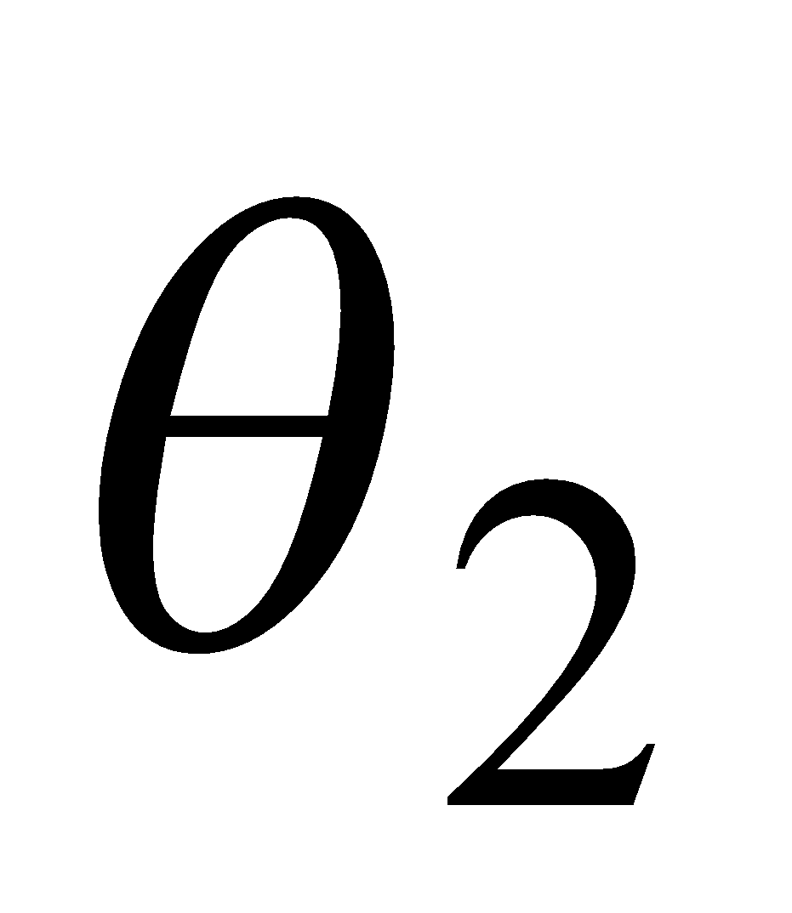
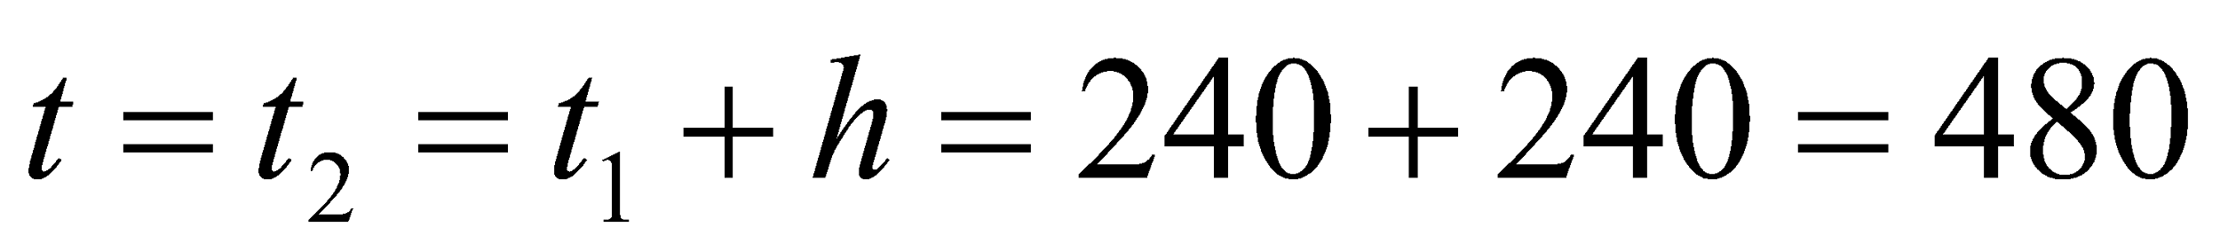
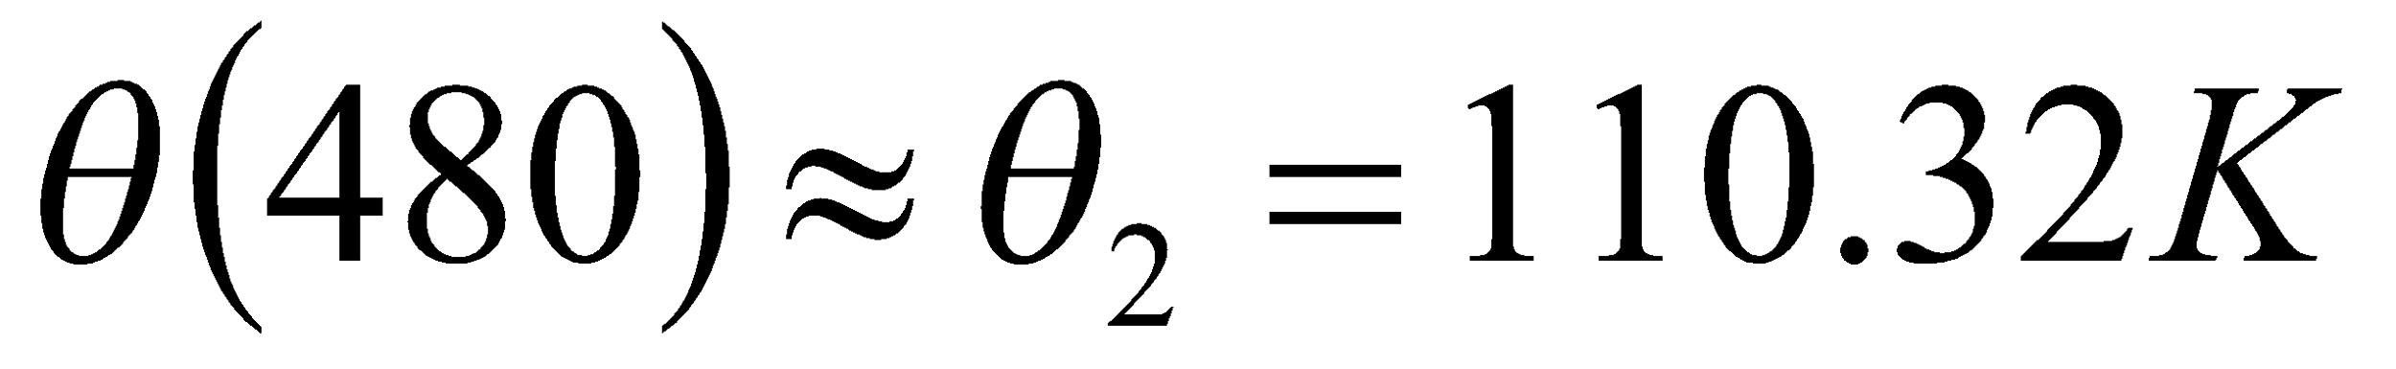
Solution Cont
Step 2:
For
is the approximate temperature at
‹#›

Slide 8
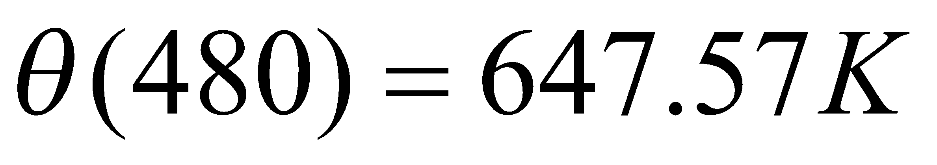
Solution Cont
The exact solution of the ordinary differential equation is given by the solution of a non-linear equation as
The solution to this nonlinear equation at t=480 seconds is
‹#›

Slide 9
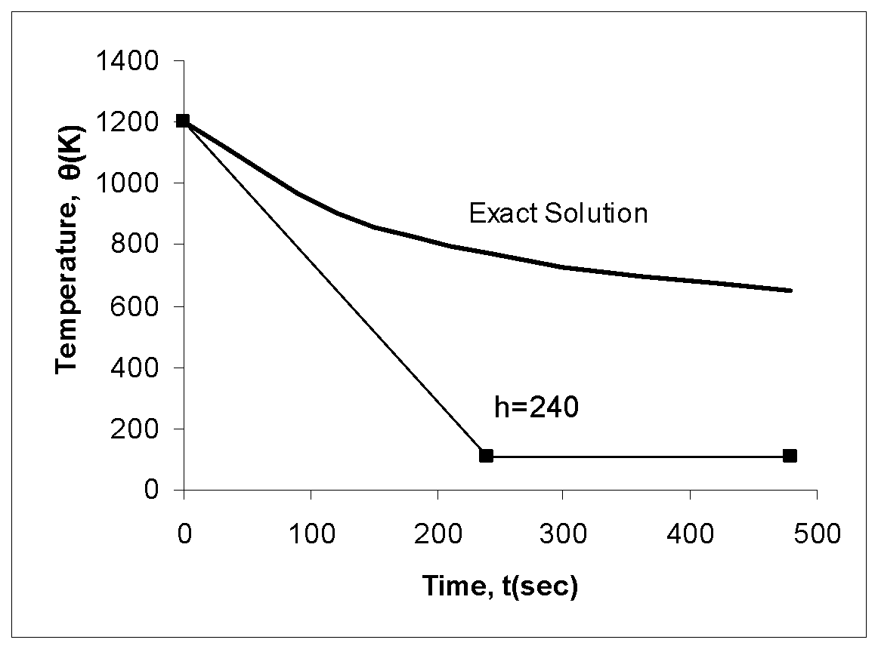
Comparison of Exact and Numerical Solutions
Figure 3. Comparing exact and Euler’s method
‹#›

Slide 10
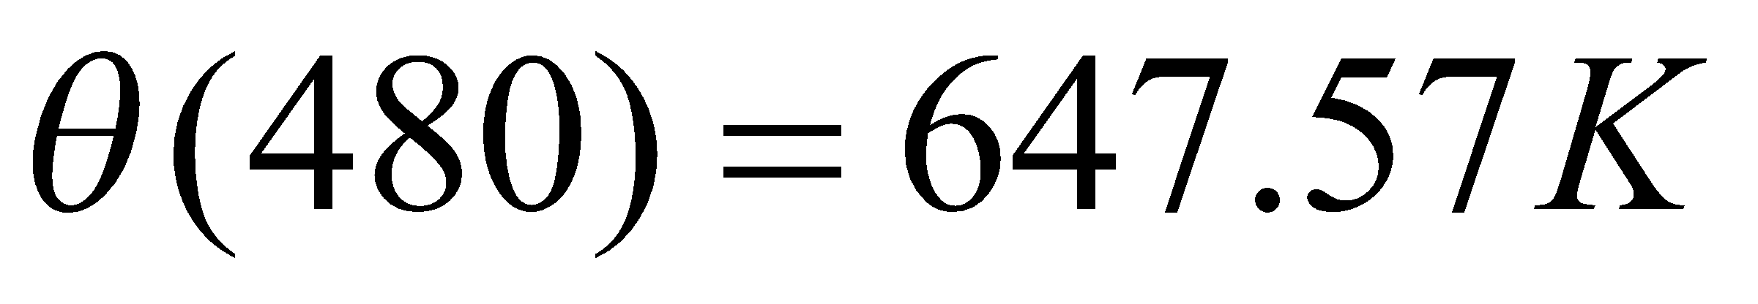
Effect of step size
Table 1. Temperature at 480 seconds as a function of step size, h
Step, h | θ(480) | E_{t} | |є_{t}|%
480 240 120 60 30 | −987.81 110.32 546.77 614.97 632.77 | 1635.4 537.26 100.80 32.607 14.806 | 252.54 82.964 15.566 5.0352 2.2864
(exact)
‹#›

Slide 11
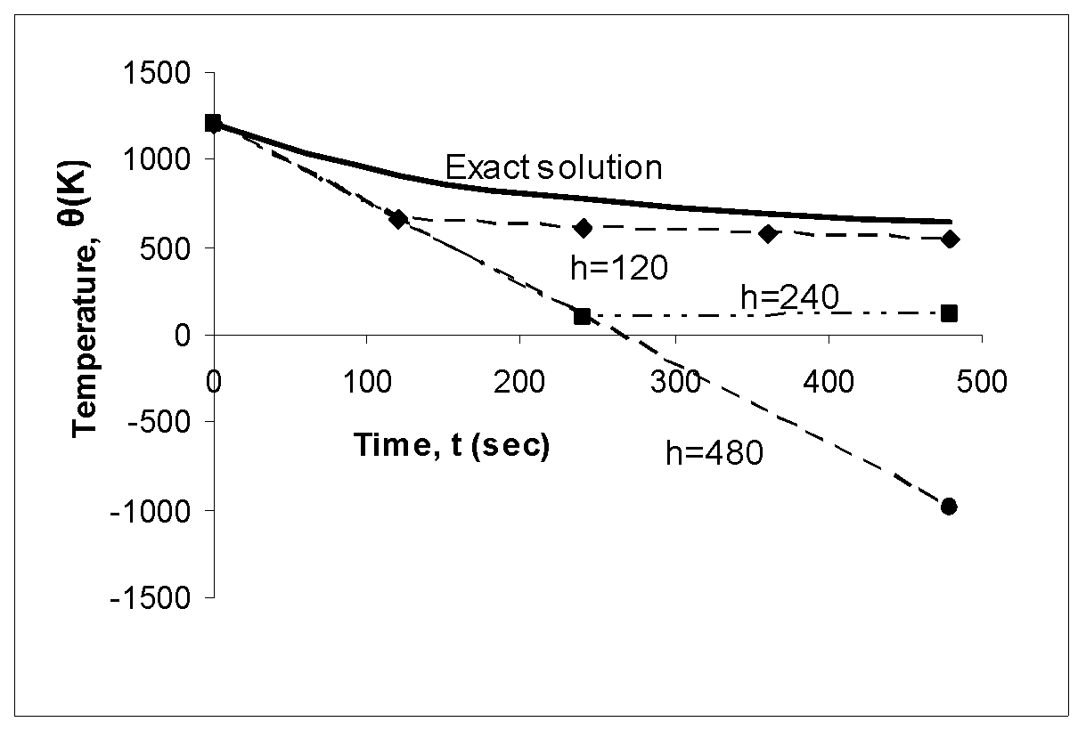
Comparison with exact results
Figure 4. Comparison of Euler’s method with exact solution for different step sizes
‹#›

Slide 12
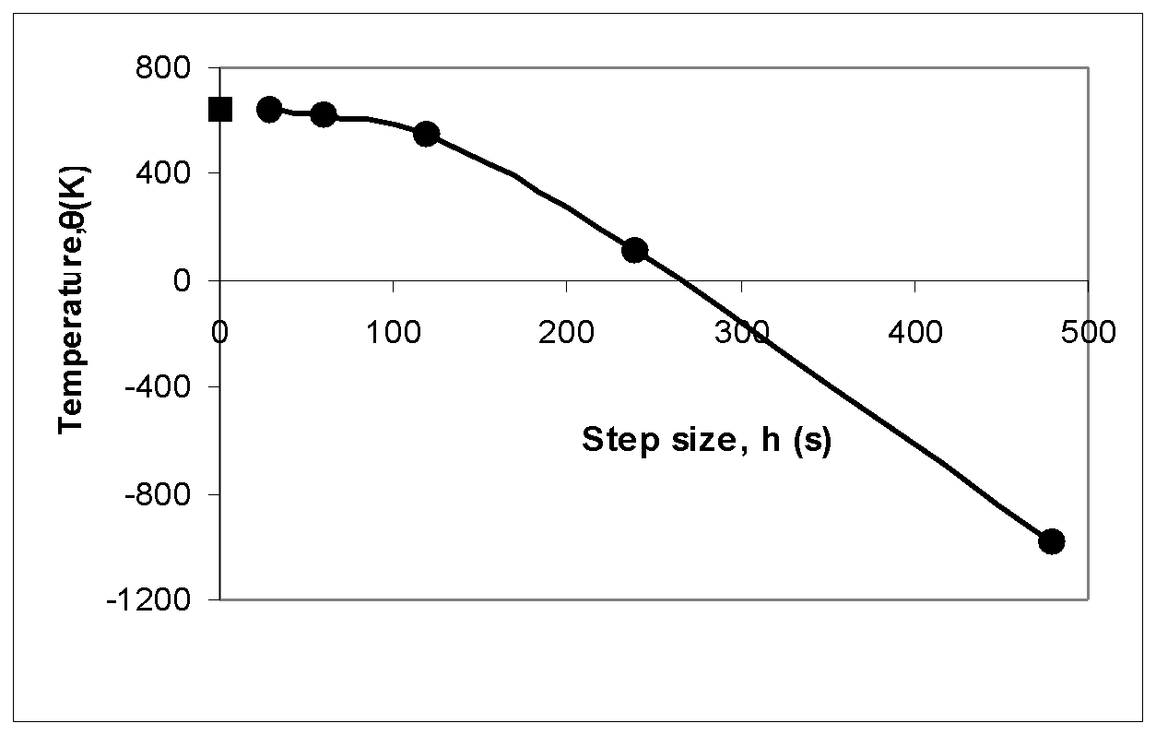
Effects of step size on Euler’s Method
Figure 5. Effect of step size in Euler’s method.
‹#›

Slide 13
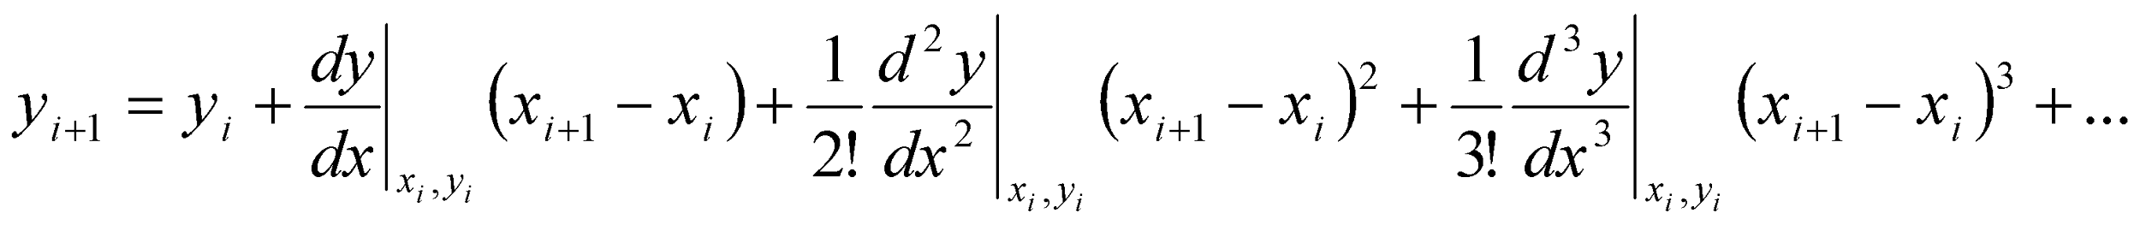
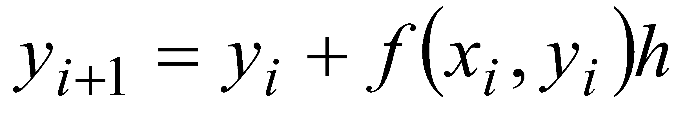
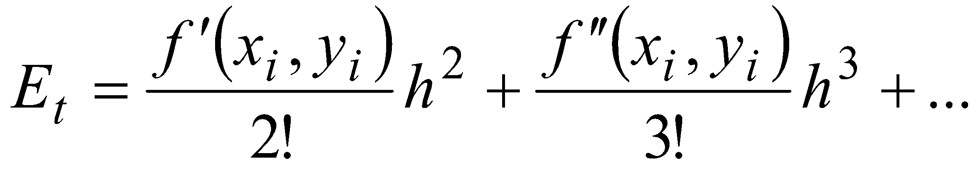
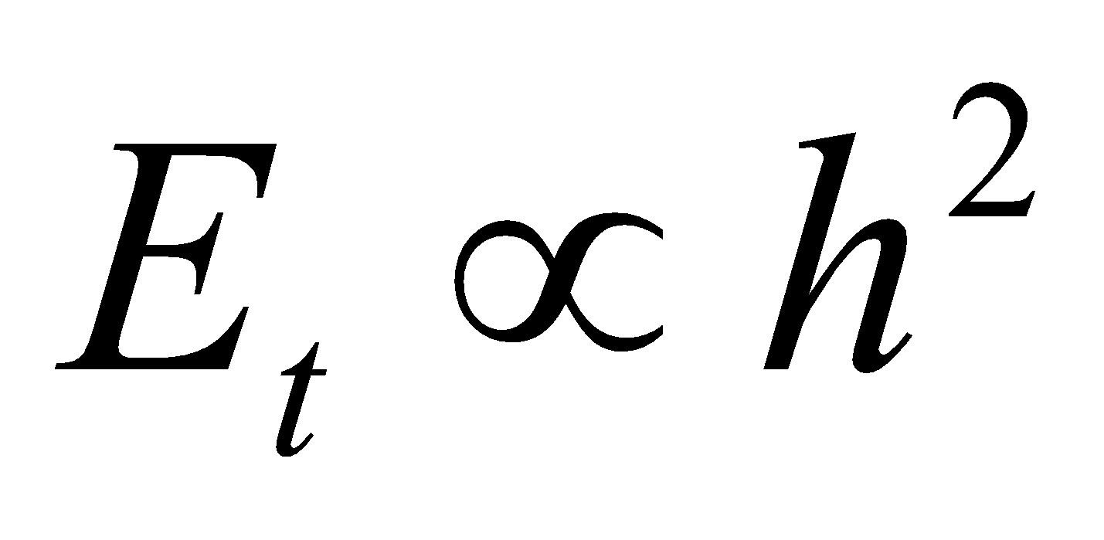
Errors in Euler’s Method
It can be seen that Euler’s method has large errors. This can be illustrated using Taylor series.
As you can see the first two terms of the Taylor series
are the Euler’s method.
The true error in the approximation is given by
‹#›

Slide 14
THE END
Notes:
‹#›

